Slide 1
Project 1- Briefing
Customer wants to use Azure for its test and dev environment and UAT of its mission critical applications.
Customer wants backup of its test and development environment with point in time restore.
Customer wants to automated jobs like shutdown of the VM when not in use for more than 60 Min etc.

Slide 2



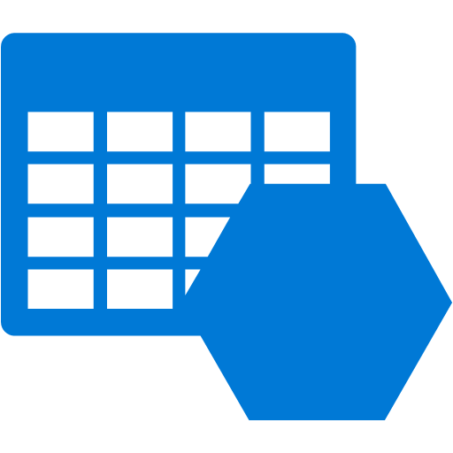





Dev Resource Group
DC Resource Group
Test Resource Group
Web Subnet
Web Subnet
LB
LB
Domain Controller 1
Domain Controller 2
DC RG Owner
Dev RG Owner
Web Server 1
Web Server 2
Web Server 3
Web Server 4
Web Server 5
Test RG Owner
Web Server 1
Web Server 2
Web Server 3
Web Server 4
DC RG Contributor
Dev RG Contributor
ILB
ILB
Test RG Contributor
DB Subnet
DC RG Operator (Custom Role)
Dev RG Operator (Custom Role)
ILB- Listener
DB Subnet
Storage - LRS
ILB- Listener
Test RG Operator (Custom Role)
SQL Server 1
SQL Server 2
SQL Server 3
SQL Server 1
SQL Server 2
SQL Server 3
SQL Server 4
SQL Server 5
Azure Automation and Scripting
Backup Service
Backup Vault
Azure Automation and Scripting
Storage - LRS
Gateway Subnet
Storage - LRS
Test & Dev Environment is replica of each other and share the same DC
VMs of Each Tire to be part of Availability Set
Web Front end server will be configure in load balancing and SQL will in standalone.
Azure Backup will be configured to protect all the VM instances
Express Route or S2S VPN
Customer Premises

Slide 3
Project 2- Briefing
Customer wants to use Azure as BCDR.
Customer wants same IP address in Azure to minimize downtime incase of disaster failover.
Customer wants to use existing office 365 with on-prem AD identity and SSO.

Slide 4










Microsoft Azure
Web Servers
HIS App Servers
Windows Server
Database Server
ADFS Proxy
ADFS Server
AD Connect
Add Domain Controller
Config Server
ASR Replication
Azure Storage
Target Server
Express Route
SQL Availability Group
Extended Domain
Process Server
Web Servers
HIS App Servers
Windows Server
Database Server
DC and DNS
Customer Datacentre
SAN Storage

